Slide 1
TDD Mob Session

Slide 2
Why TDD?
Thinking Tool
Iterative process to solve a problem
Allows for changing code without fear of breaking things
Allows for refactoring and cleaning up code base
Tests After ?

Slide 3
Rules OF TDD
You must write a failing test before you write any production code.
You must not write more of a test than is sufficient to fail, or fail to compile.
You must not write more production code than is sufficient to make the currently failing test pass.

Slide 4
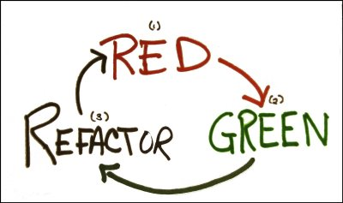

Slide 5
reFERENCES
https://blog.cleancoder.com/uncle-bob/2014/12/17/TheCyclesOfTDD.html

